Slide 1
2: Developing a Multisensory Curriculum
2D: Multisensory Maths
www.multisensorylearning.lgfl.net ©2018 www.hirstwood.com & London Grid for Learning

Slide 2
Maths
Multisensory learning is not just for literacy and to support storytelling, it can support subjects such as Maths too.
For learners with issues such as dyscalculia, as well as a range of other learning and sensory challenges, multisensory learning is particularly powerful.
There are a whole host of multisensory strategies, tools and games that can be used to help to support Maths.
www.multisensorylearning.lgfl.net ©2018 www.hirstwood.com & London Grid for Learning

Slide 3
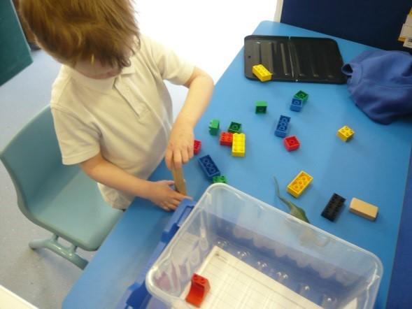
Visualising Numbers with Real Objects
Using objects such as beads or cereal is a really multisensory way to approach Maths problems.
For instance, learners can approach addition and subtraction by adding and taking away real objects such as cereal pieces from a group.
www.multisensorylearning.lgfl.net ©2018 www.hirstwood.com & London Grid for Learning

Slide 4
Visualising Numbers with Real Objects
Building objects e.g. lego can also help learners access Maths e.g. making patterns.
These objects can also be used to help learners visualise multiplication in real life.
This helps make Maths problems and concepts concrete rather than abstract which is essential for some learners
www.multisensorylearning.lgfl.net ©2018 www.hirstwood.com & London Grid for Learning

Slide 5
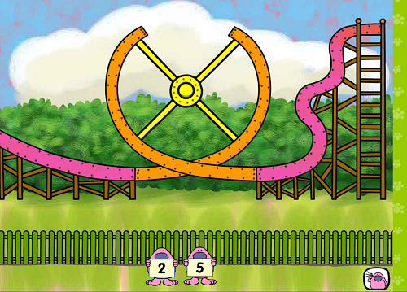
Visualising Numbers with Real Objects
The numeracy tools within LGfL’s Busy Things (www.busythings.lgfl.net) can support learners by providing engaging pictorial representation of numbers when using tablets, phones, whiteboards or computers.
As many of the activities are interactive learners also get some of the benefit of using manipulatives in a concreate way.
www.multisensorylearning.lgfl.net ©2018 www.hirstwood.com & London Grid for Learning

Slide 6
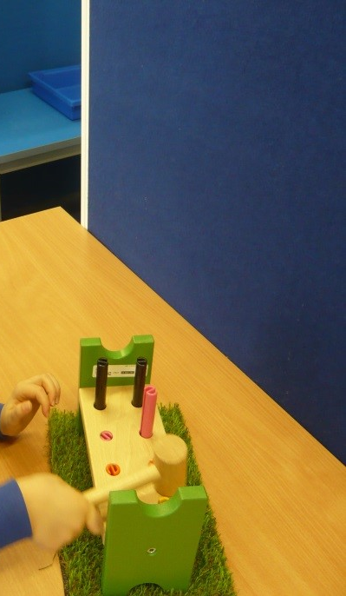
Using Music for Maths
Some experts say that as well as using real objects, using musical instruments to denote numbers e.g. banging a drum or even tapping hands can help learners connect to numbers and values.
www.multisensorylearning.lgfl.net ©2018 www.hirstwood.com & London Grid for Learning

Slide 7
Using Music for Maths
Children can also use songs and music to help learn mathematical concepts and rules too. Go to www.mathsraps.lgfl.net for some examples to use in class.
www.multisensorylearning.lgfl.net ©2018 www.hirstwood.com & London Grid for Learning

Slide 8
Putting Movement Into Maths
Using movement also helps many learners retain understanding of mathematical concepts.
Examples include using a ball with numbers written on it which is thrown and caught. The learner does the Maths addition, subtraction, multiplication or division problem with the numbers his/her hands are touching.
www.multisensorylearning.lgfl.net ©2018 www.hirstwood.com & London Grid for Learning

Slide 9
Putting Movement Into Maths
Working with hula hoops can support with maths problems involving circles
Learners can also complete jumping activities to support them to solve Maths problems e.g. jumping back and forth over the bench for 2 x table.
www.multisensorylearning.lgfl.net ©2018 www.hirstwood.com & London Grid for Learning

Slide 10
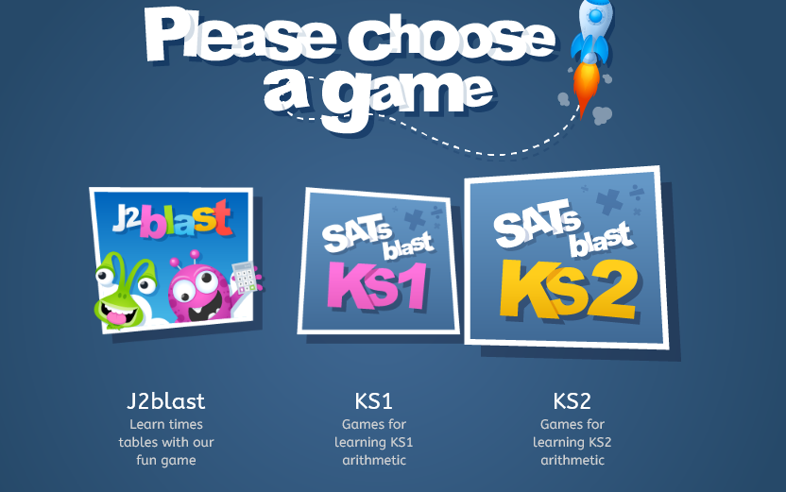
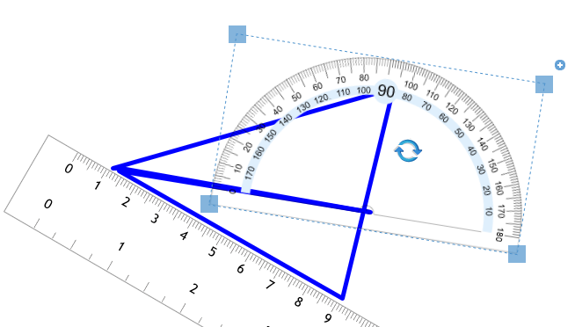
Here are some more Inclusive LGfL resources to support Maths…..
http://www.j2blast.lgfl.net
http://www.j2measure.lgfl.net
www.multisensorylearning.lgfl.net ©2018 www.hirstwood.com & London Grid for Learning

Slide 11
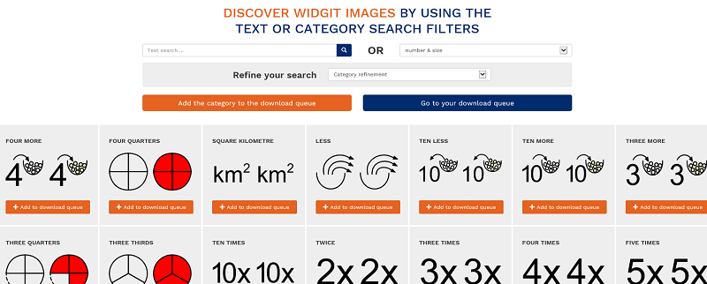
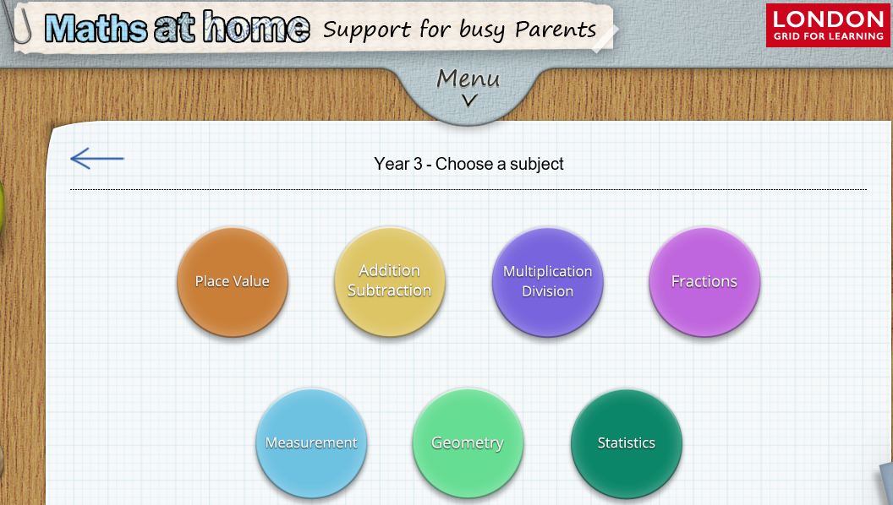
http://www.mathsathome.lgfl.net
Widgit - http://www.widgit.lgfl.net
www.multisensorylearning.lgfl.net ©2018 www.hirstwood.com & London Grid for Learning

Slide 12
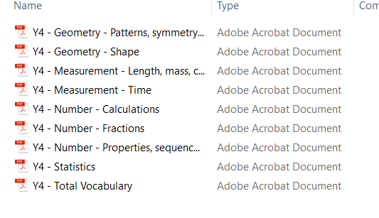
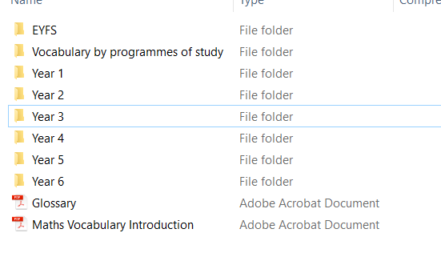
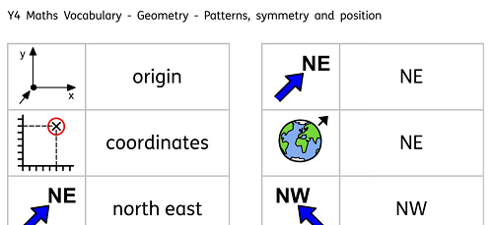
Widgit – http://www.widgit.lgfl.net
www.multisensorylearning.lgfl.net ©2018 www.hirstwood.com & London Grid for Learning

